Slide 1
Computer Architecture & Assembly Language CSC-250
COURSE LECTURE
COMPUTER SCIENCE DEPARTMENT
SIBAU KANDHKOT CAMPUS

Slide 2
Topics
The Arithmetic and Logic Unit
Integer Representation
Integer Arithmetic
Floating point representation
Floating point arithmetic
RAID

Slide 3
CPU & GPU
A Central Processing Unit (CPU) is the brains of your computer. The main job of the CPU is to carry out a diverse set of instructions through the fetch-decode-execute cycle to manage all parts of your computer and run all kinds of computer programs.
A Graphics Processing Unit (GPU) is a specialized processor whose job is to rapidly manipulate memory and accelerate the computer for a number of specific tasks that require a high degree of parallelism.

Slide 4
GPU Architecture
As the GPU uses thousands of lightweight cores whose instruction sets are optimized for dimensional matrix arithmetic and floating point calculations, it is extremely fast with linear algebra and similar tasks that require a high degree of parallelism.
As a rule of thumb, if your algorithm accepts vectorized data, the job is probably well-suited for GPU computing.
Architecturally, GPU’s internal memory has a wide interface with a point-to-point connection which accelerates memory throughput and increases the amount of data the GPU can work with in a given moment. It is designed to rapidly manipulate huge chunks of data all at once.

Slide 5
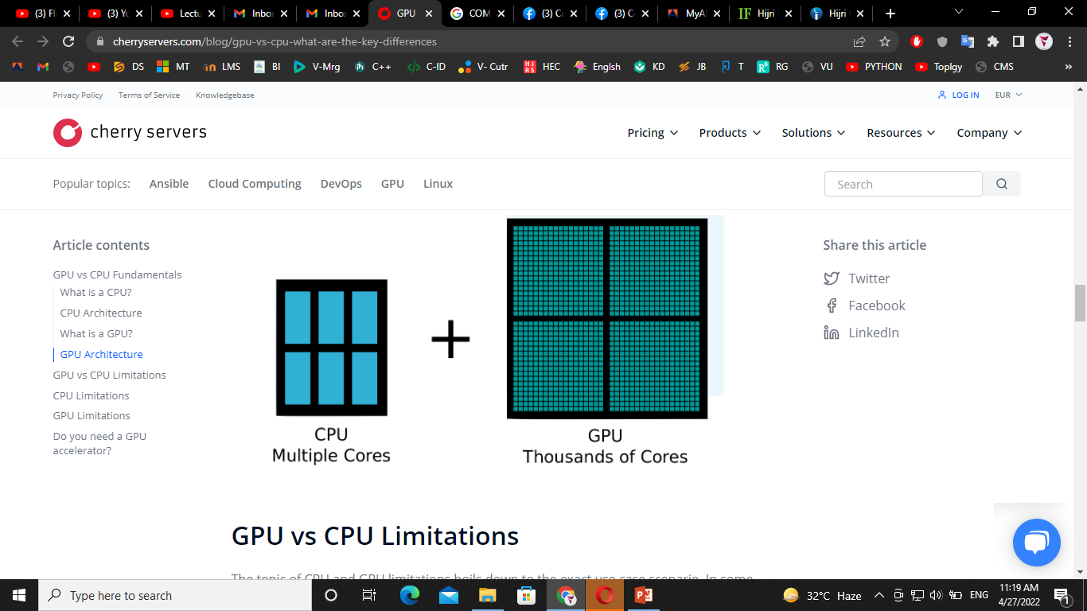

Slide 6
GPU vs CPU Limitations
The topic of CPU and GPU limitations boils down to the exact use case scenario. In some cases, a CPU will be sufficient, while other applications may benefit from a GPU accelerator.
Let’s now uncover some general weak spots of CPU and GPU processors to help you decide on whether you need both of them or not.
CPU Limitations
Heavyweight Instruction Sets
A tendency to embed increasingly complex instructions into CPU hardware directly is a modern trend that has its downside.
In order to execute some of the more difficult instructions, a CPU will sometimes need to spin through hundreds of clock cycles. Although Intel uses instruction pipelines with instruction-level parallelism to mitigate this limitation, it is becoming an overhead to overall CPU performance.

Slide 7
Cont...
Context Switch Latency
Context switch latency is time needed for a CPU core to switch between threads. Switching between tasks is quite slow, because your CPU has to store registers and state variables, flush cache memory and do other types of clean up activities.
Though modern CPU processors try to facilitate this issue with task state segments which lower multi-task latency, context switching is still an expensive procedure.
Moore's Law
The notion that the number of transistors per square inch on an integrated circuit doubles every two years may be coming to an end. There is a limit to how many transistors you can fit on a piece of silicon, and you just cannot outsmart Physics.
Rather, engineers have been trying to increase computing efficiency with the help of distributed computing, as well experimenting with quantum computers and even trying to find a silicon replacement for CPU manufacturing

Slide 8
GPU Limitations
Less Powerful Cores
Although GPUs have many more cores, they are less powerful than their CPU counterparts in terms of clock speed. GPU cores also have less diverse, but more specialized instruction sets. This is not necessarily a bad thing, since GPUs are very efficient for a small set of specific tasks.
Less Memory
GPUs are also limited by the maximum amount of memory they can have. Although GPU processors can move a greater amount of information in a given moment than CPUs, GPU memory access has much higher latency.
Limited APIs
The most popular GPU APIs are OpenCL and CUDA. Unfortunately, they are both renowned for being hard to debug.
Although OpenCL is open source, it is quite slow on Nvidia hardware. CUDA, on the other hand, is a proprietary Nvidia API and is optimized for Nvidia GPUs, but it also automatically locks you in their hardware ecosystem.

Slide 9
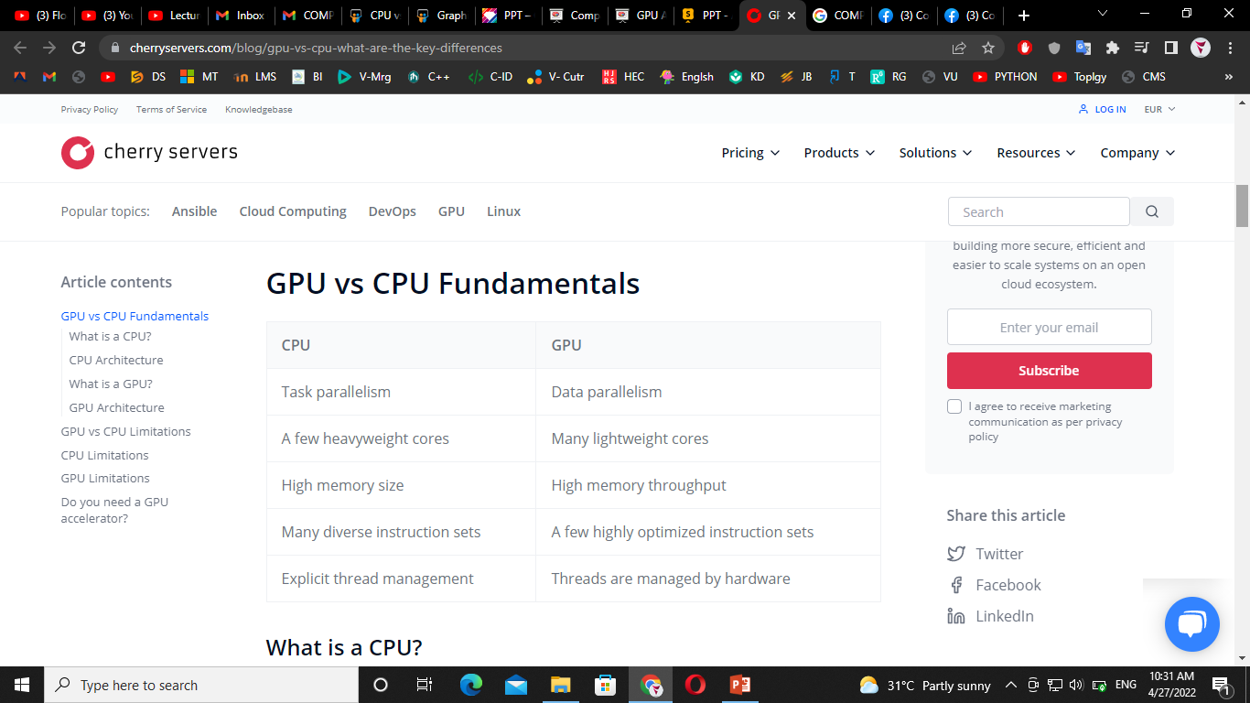

Slide 10
Syllabus
Integer Representation, including:
Sign and modulus
One’s complement
Two’s complement
Representation of Fractions
Floating point or real.
IEEE

Slide 11
What is Integer Representation About?
To fully understand how binary numbers are processed we must have an understanding of how integers are handled by the computer.
For example:
●
●
●
How are negative numbers represented? How are floating point numbers represented?
Processing – How do we add, subtract, divide and multiply?

Slide 12

How can we represent a binary number?
??????
Maybe
NO
- 000111001

Slide 13
How can we represent a binary number?
Binary number can only be represented by a 0 or 1, so we cannot use a (-) to denote a negative number.
Therefore, we cannot use a specialised symbol so it must be either a 0 or 1.
There are THREE methods used, they are:

Slide 14
Sign and Modulus
This method uses the far left-hand bit which is often referred to as the sign bit.
The general rule is that a positive number starts with 0 and a negative number starts with a 1.
+ 28 = 0 0011100
SIGN
Modulus

Slide 15
ACTIVITY 1
Using ONE byte what is the maximum positive and negative integer that can represented using sign and modulus.
Convert the following numbers to binary using sign and modulus.
●
●
●
122
-100
-264

Slide 16
One’s Complement
What is a complement?
It is the opposite of something.
Because computers do not like to subtract, this method finds the complement of a positive number and then addition can take place.
-127
-75
0
75
127

Slide 17
One’s Complement
Example
Find the one’s complement of +100
Convert +100 to binary.
Swap all the bits.
Check answer by adding -127 to your result.

Slide 18
One’s Complement
Example
127
●
●
+100 = 01100100₂
01100100₂
10011011₂
-27
●
●
10011011₂ = -27₁₀
127₁₀ + -27₁₀ = 100₁₀
-62
65
100
-127

Slide 19
ACTIVITY 2
1. Convert the following binary numbers into a negative using one’s complement.
●
●
0110111₂
00110011
2

Slide 20
Two’s Complement
The only difference between the two processes is that the left most bit is -128₁₀ rather than -127₁₀.
The process for two’s complement is exactly the same as one’s complement, however you are then required to add 1 to the results.

Slide 21
Two’s Complement
Example
Find the two’s complement of +15₁₀
●
●
●
Convert +15₁₀ to binary. Swap all the bits.
Add 1 to the result.

Slide 22
Two’s Complement
Example
●
●
+15 = 00001111₂
00001111₂
11110000₂
●
11110000₂ +
1
11110001
●
-128 + 64 + 32 + 16 + 1 = -15₁₀

Slide 23
Two’s Complement
Rules for Adding
1 + 1 = 0 (Carry the 1)
0 + 0 = 0
0 + 1 = 1

Slide 24
ACTIVITY 3
1. Convert the following binary numbers into a negative using two’s complement.
●
●
●
00101110₂
01101000
2
01011011₂
●
A computer has a word length of 8 binary digits and uses two’s complement.
Translate -82₁₀ into a form a computer would use.

Slide 25
Answers
00101110 - 11010010
01101000 - 10011000
01011011 - 10100101

Slide 26
ANSWER
●
●
Translate 82₁₀ into binary = 01010010₂
Reverse all the bits so that 0’s become 1’s and 1’s become 0’s.
10101101 = -82₁₀ in one’s complement. Complete two’s complement.
Answer = 10101110₂
●
●
●

Slide 27
Representation of Fractions
What are they?
Fractional numbers are numbers between 0 and 1.
They are called real numbers in computing terms.
Real numbers contain both an integer and fractional part.
E.g. 23.714 OR 01101.1001

Slide 28

Methods Used:
Computers use two main methods to represent real numbers:
They are:
●
●
Fixed point Floating point

Slide 29
Fixed Point
This method assumes the decimal point is in a fixed position.
Relies on using a fixed number of bits for both the integer and fractional parts
i.e. 5 and 3.
Example
10011101 = 10011.101

Slide 30
Fixed Point
Integer |  |  |  |  | Fractional
16 | 8 | 4 | 2 | 1 | 0.5 | 0.25 | 0.125
1 | 0 | 0 | 1 | 1 | 1 | 0 | 1
Therefore
16 + 2 + 1 = 19 (Integer)
0.5 + 0.125 = 0.625 (Fraction)
So 10011.101 = 19.625

Slide 31

Fixed Point
Problems are:
You fix the numbers that you can represent
i.e. you are limited to amount of numbers that you can actually represent.

Slide 32
Activity 4
Convert the following binary numbers to decimal.
a. 101.11
b. 110.101
Convert the following decimal numbers to binary.
a. 2.25
b. 0.875

Slide 33
Activity 4
1. Identify what number 11001101 would represent in the integer /fractional ratio was:
a. 6:2
b. 5:3
c: 4:4

Slide 34
Floating Point
This is the preferred method because you can represent large numbers.
This uses exponential notation which highlights two specific parts of a decimal number:
●
●
Mantissa – Fractional part.
Exponent – Is the power by 10 which the mantissa is multiplied.

Slide 35
Floating Point
Example
●
●
●
The aim of floating point representation is show how many numbers before or after the decimal point.
-241.65 | = | -0.24165 x 10³
0.0028 | = | 0.28 x 10⁻²
110.11 | = | 0.11011 x 2³

Slide 36
Activity 5
Identify the floating point representation of the following numbers.
1. 3776.56
2. 10001.11
3. 0.0000010100
4. 10.001001

Slide 37
Floating Point
But there is more!
●
A computer will represent a binary number into THREE parts:
Sign Bit
Mantissa
Exponent

Slide 38
Floating Point
Convert the following binary number to decimal using floating point notation.
01101011
Sign Bit
Exponent
Mantissa

Slide 39
Floating Point
Steps
2. Convert the mantissa to decimal.
0.5 | 0.25 | 0.125 | 0.0625
1 | 1 | 0 | 1
8. 0.5 + 0.25 + 0.0625 = 0.8125

Slide 40

Floating Point
Steps
●
●
●
●
●
Convert the exponent. 011 = 3
Therefore 2³ = 8
0.8125 x 8 = 6.5
Answer = 6.5

Slide 41
Floating Point
More on Floating Point Numbers
The Institute of Electrical and Electronics Engineers has produced a standard for representing binary numbers using the floating point system.
●
●
●
IEEE 32 bit
IEEE 64 bit

Slide 42
IEEE 32 Bit
32 Bits
1 11001010
00000000000000000011001
Sign Bit (1 bit)
Exponent (8 bits)
Mantissa (23 bits)

Slide 43
IEEE 32 Bit
Example – Convert 24.25 to an IEEE 32 bit number.
Convert 24.25 to binary.
24.25 = 11000.01
Normalise
11000.01 = 1.100001 x 2⁴
Determine the sign bit, mantissa and exponent.

Slide 44
IEEE 32 Bit
Sign Bit = 0 (Because it is a + number)
Mantissa = 100001
Exponent = 127 (Largest) + 4 = 131
0 10000011 00000000000000000010001

Slide 45
Activity 6
Convert the following number using IEEE 32 bit format.
418.125

